Slide 1
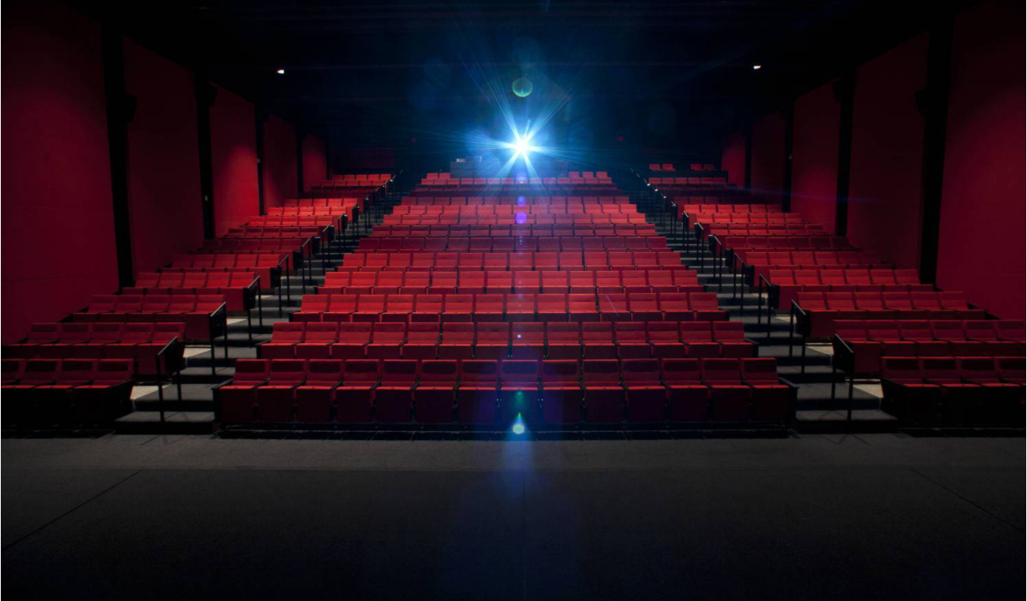
SOUND & SCREEN CHECK

Slide 2
This presentation is dedicated with love and respect to
XALTIUS
who made us believe
“anyone has the POWER to BI.”
Aditya was thoroughly convinced
of my proposal (and SQL and Excel dashboard building skills)
and has since commenced production on his debut movie production.
and Aditya is once again, restless…
Being the slave-driver that he is,
he now shifts his attention back to his Superstore business…
Old habits die hard, and once again, he has tasked the project to me…
with his side objective of measuring my aptitude in Power BI…
However, with the COVID-19 pandemic in play,
progress in production has been slow…
2 months had passed
since my last presentation proposal to produce a horror movie.
… and is requesting for an “app-like experience”
for his Global Superstore Sales-Heads
to use and drive actionable insights towards business improvement.

Slide 3
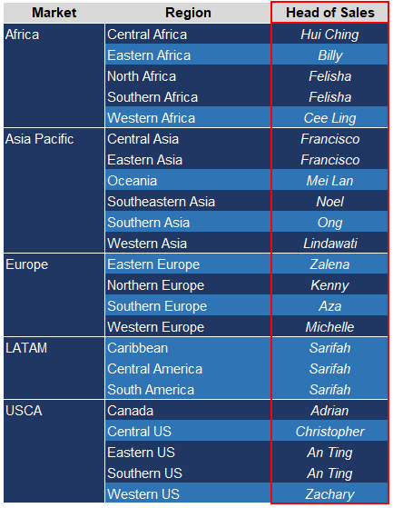
Background Story
Aditya is OUR boss
He owns the Global Superstore
He has tasked me to do up a Power BI dashboard
for his Sales Heads
EVERYONE of you guys
are the
HEAD OF SALES by REGION !

Slide 4
GLOBAL SUPERSTORE

Slide 5
AGENDA
SUPERSTORE
Objective
- How will this benefit you
Behind the Scenes
- Introduction to dataset
- Understanding the dataset
- Process (Importing, structuring, data prep, visualizing and formatting the data)
Interactive Dashboard
- How will this help you and how to use it
Business Insights
- Trends, key highlights, action points

Slide 6
OBJECTIVE
SUPERSTORE
Brief run-through of end-to-end process,
with the primary objective of
training how to use the Power BI Interactive Dashboard
to derive actionable business insights
which will improve status quo.

Slide 7
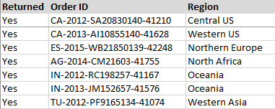
BEHIND THE SCENES
SUPERSTORE
SOURCE
IT Department
( Or rather, https://data.world/vikas-0731/global-super-store/workspace/file?filename=Data+and+Visualization.pdf )
FILES
Orders
Returns

